Slide 1



Blockchain-based Peer-to-Peer Network in Python
Author: Pi
Date: 2025.XX.XX

Slide 2
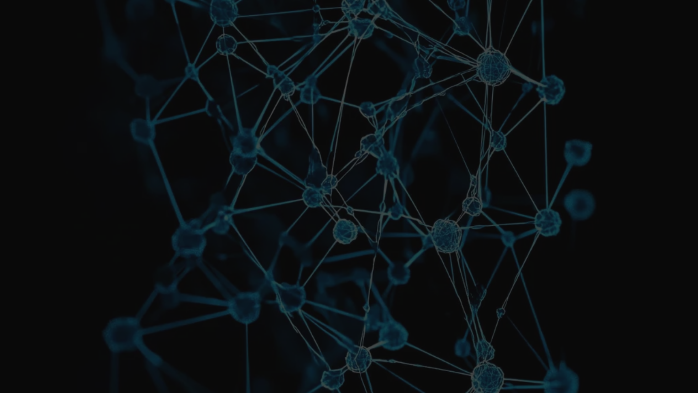
CONTENTS
1. Overview
2. Wallet Creation
3. Transaction Creation
4. Transaction Validation
5. Mining a Block
6. Blockchain Structure
7. P2P Network and Communication
8. Broadcasting Logic
9. Summary

Slide 3
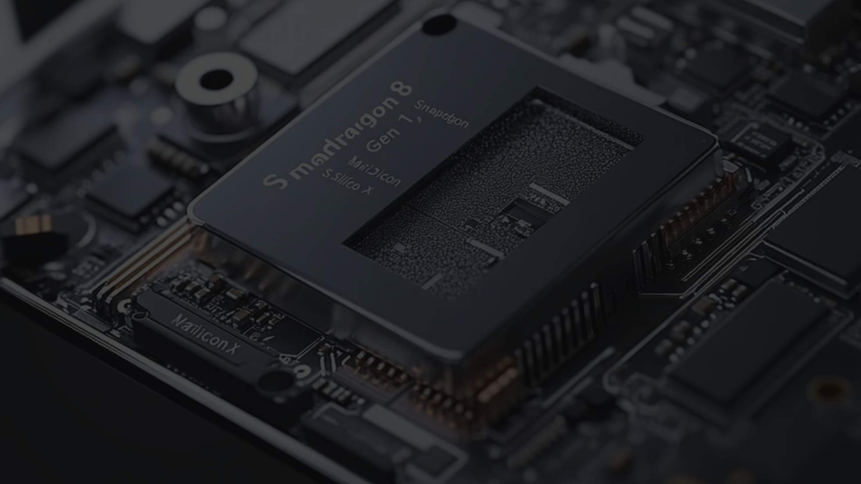
01
Overview

Slide 4
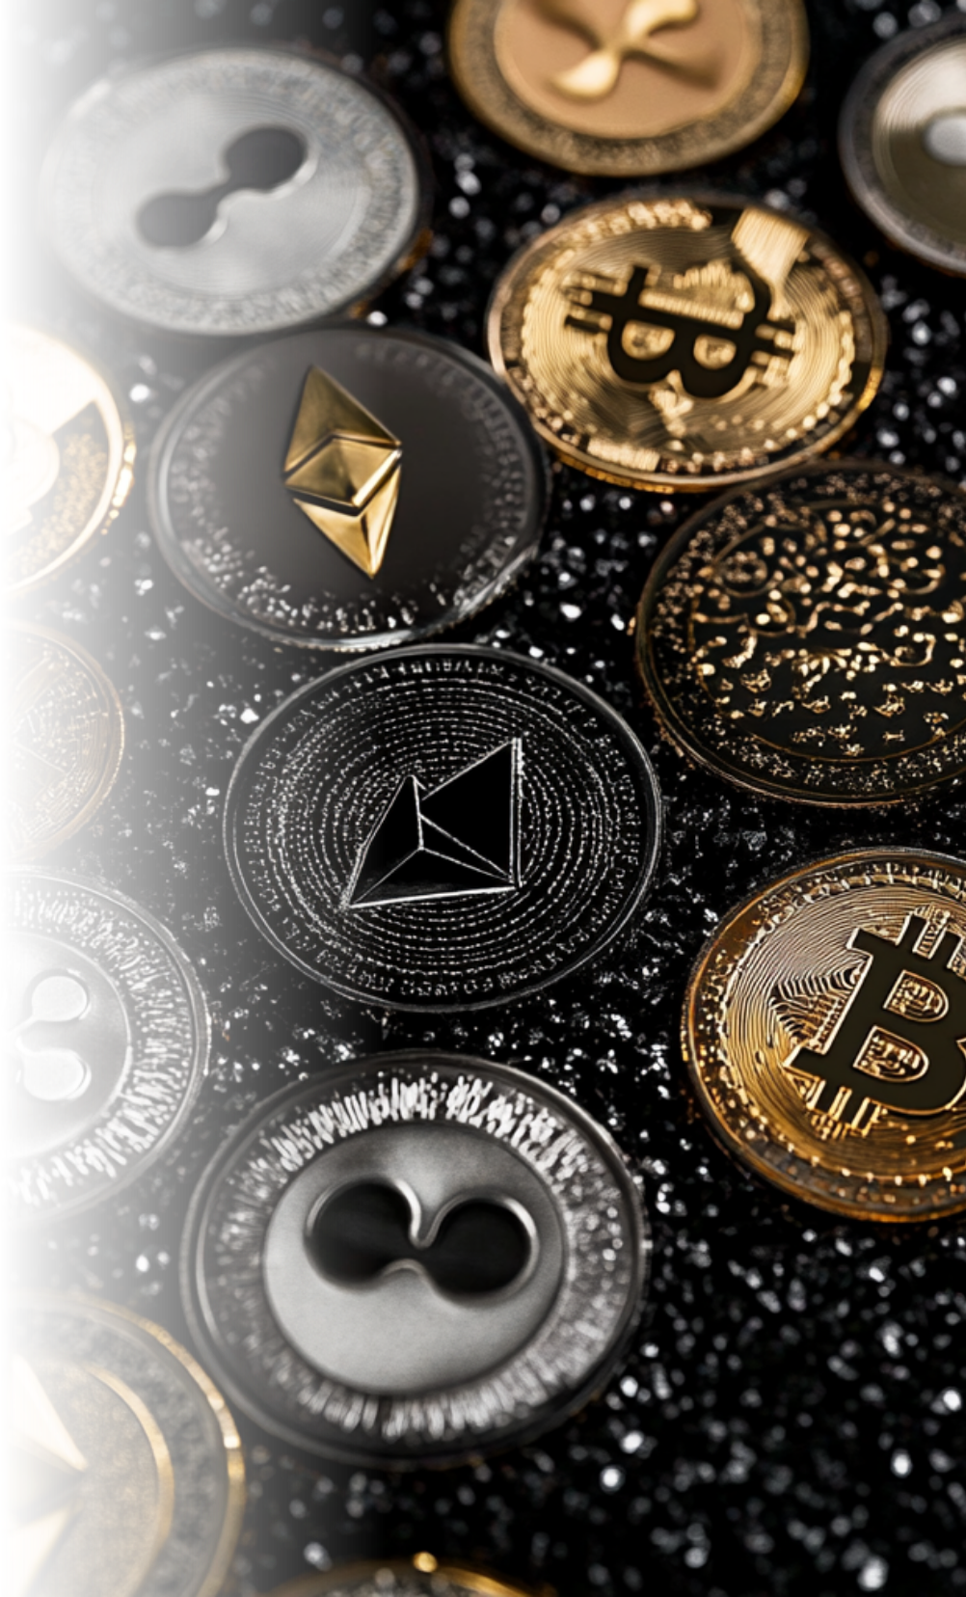
Goal
Implement a simplified blockchain system with:
•Wallet creation using public/private keys
•Transactions between peers
•Block creation through mining
•Peer-to-peer broadcasting of blocks

Slide 5
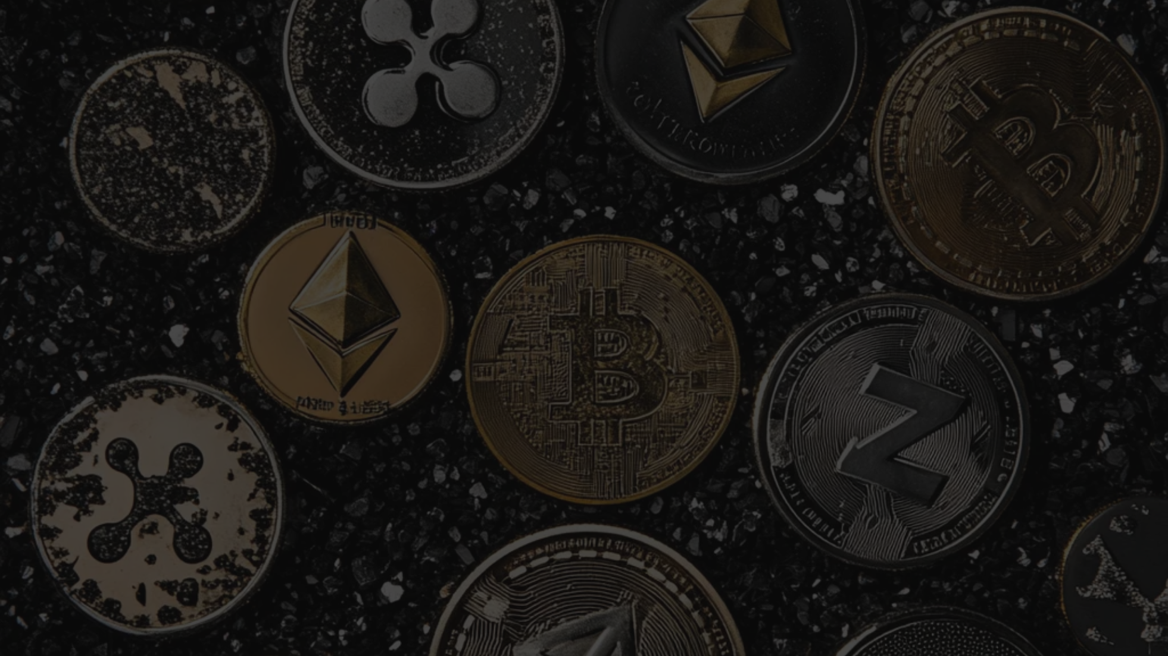
02
Wallet Creation

Slide 6

Purpose
Each user has a unique identity via cryptographic keys.

Slide 7
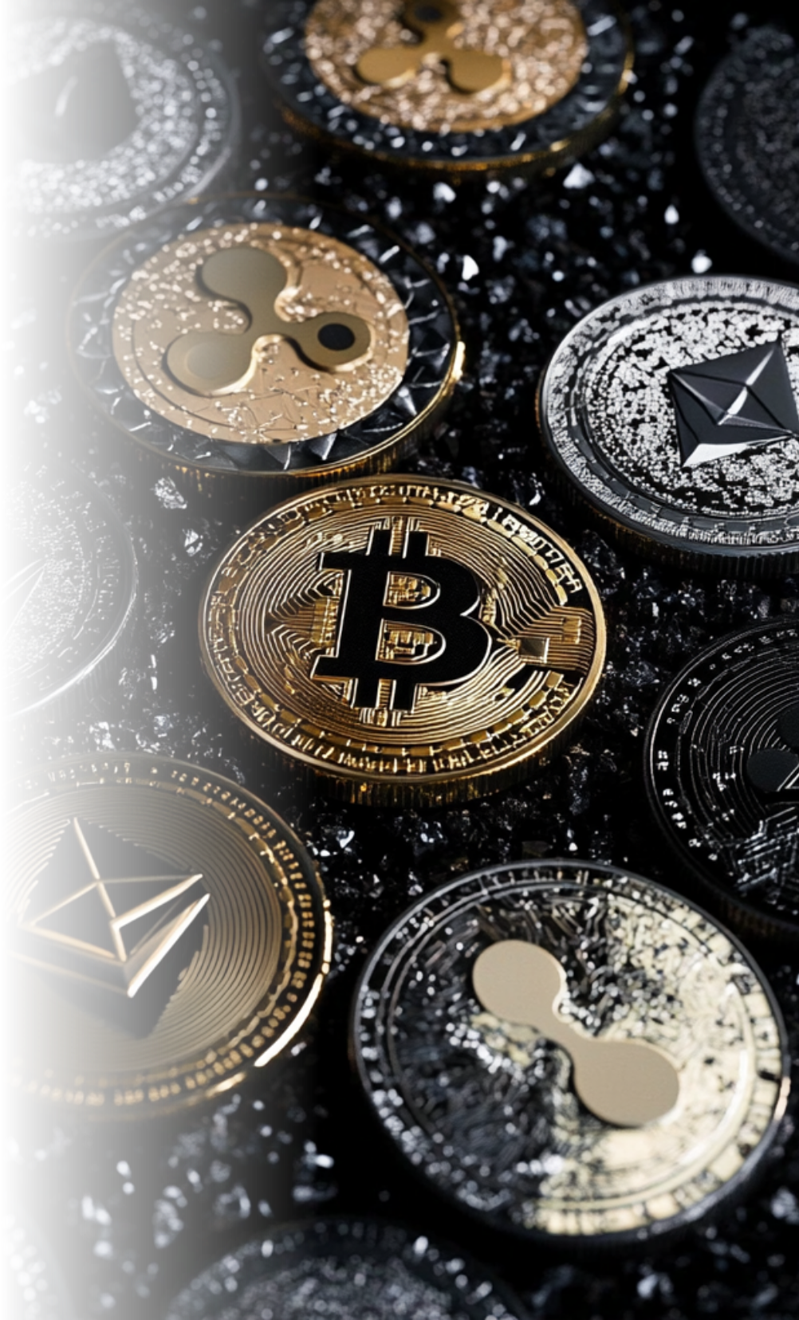
Logic
Generate ECDSA (Elliptic Curve Digital Signature Algorithm) key pair.
•Public key: shared for identification.
•Private key: used to sign transactions.

Slide 8

Data
private_key and public_key (in hex format).

Slide 9

03
Transaction Creation

Slide 10
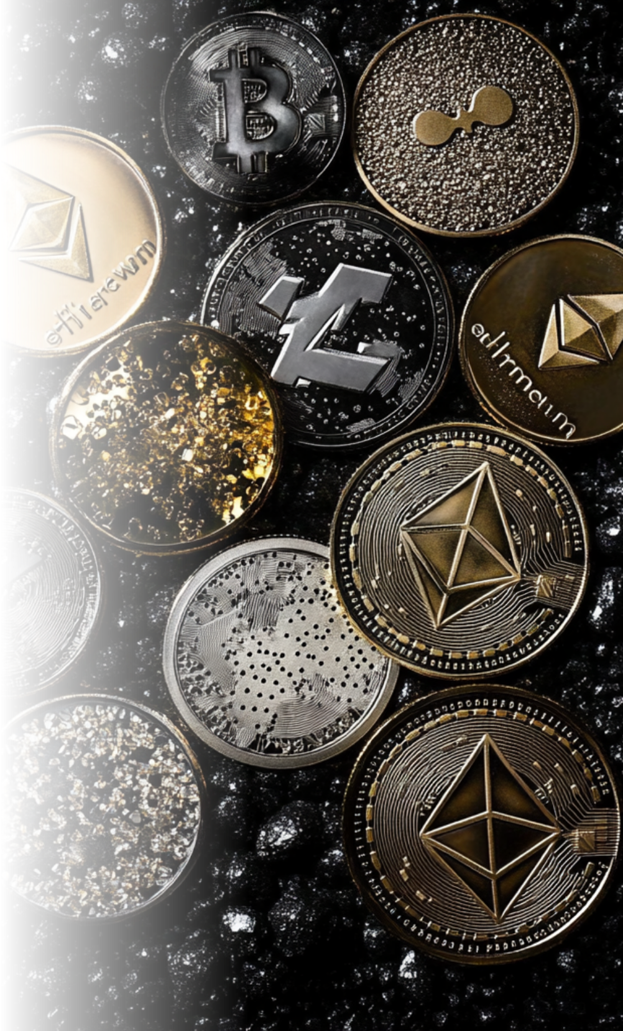
Purpose
Represent value transfers between wallets.

Slide 11

Logic
A transaction includes sender, recipient, and amount.
Sender signs the transaction using their private key to prove authenticity.

Slide 12

Data
sender, recipient, amount, signature.

Slide 13

04
Transaction Validation

Slide 14


Transaction Validation
1
Purpose
•Ensure that only legitimate transactions are included.
2
Logic
•Verify that the signature matches the transaction content using sender's public key.
3
Flow
•Get sender's public key.
•Use it to verify the signature of the transaction.

Slide 15

05
Mining a Block

Slide 16
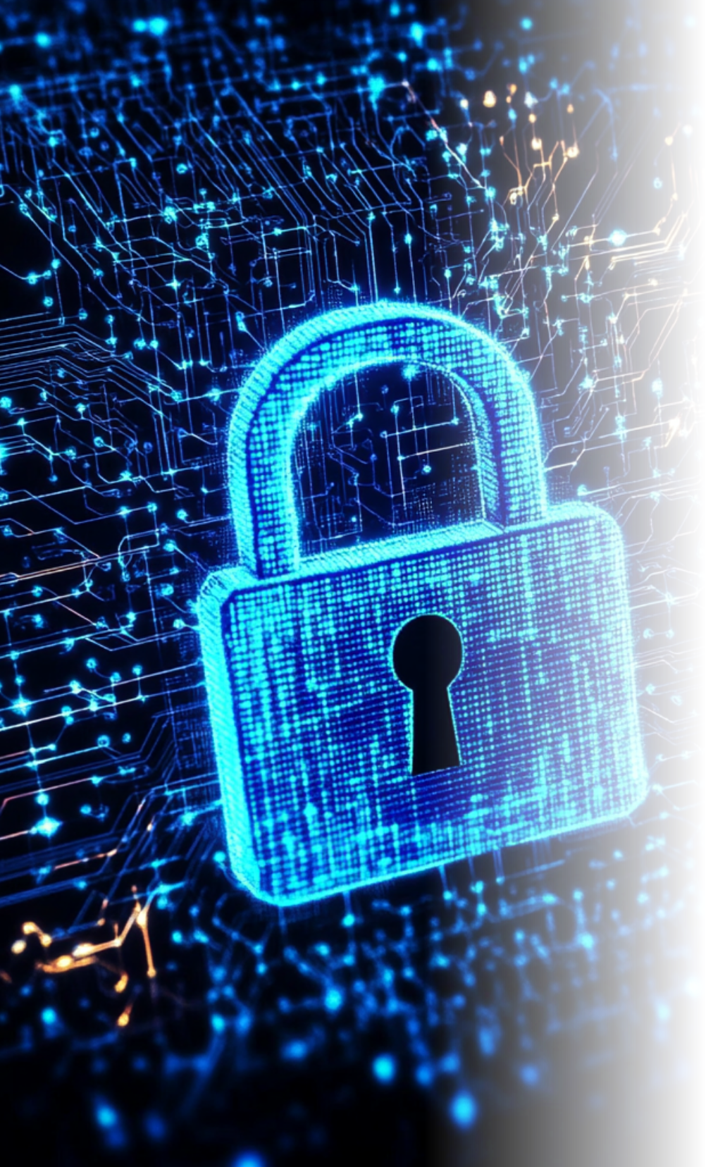
Purpose
Secure the network and create new blocks.

Slide 17


Logic
Use proof-of-work to find a nonce such that the block hash starts with certain zeros.
Include valid transactions in the block.

Slide 18

Data in a Block
index, timestamp, transactions, previous_hash, nonce, hash.

Slide 19

06
Blockchain Structure

Slide 20




Blockchain Structure
Logic
•Each block contains the hash of the previous block.
•Any change in the chain breaks the hashes.
Purpose
Genesis Block
•Maintain a tamper-proof record of transactions.
•First block with hardcoded values and no transactions.
2
1
3

Slide 21
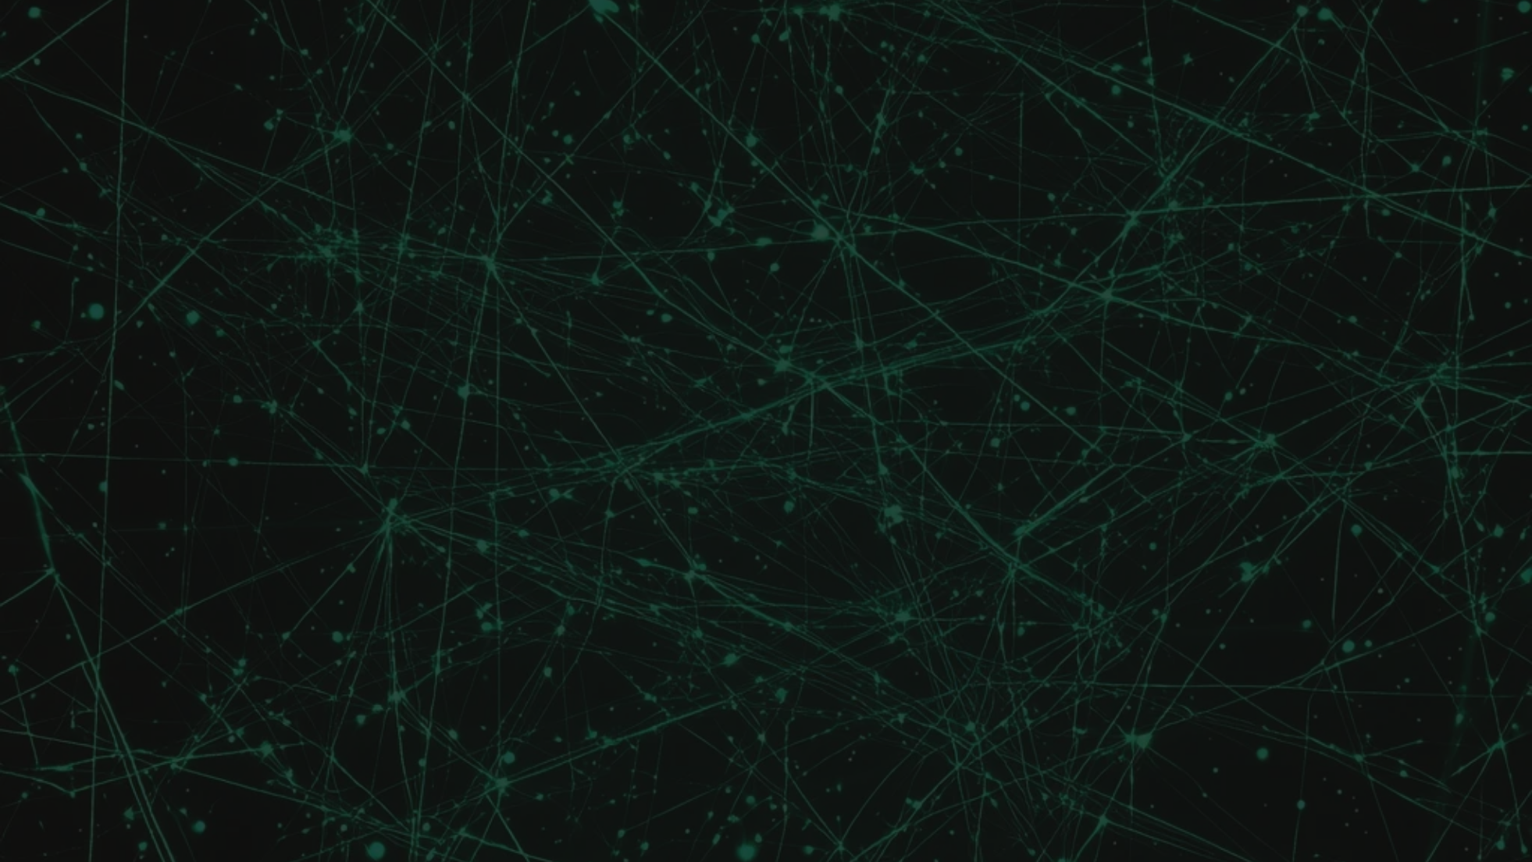
07
P2P Network and Communication

Slide 22

Purpose
Ensure decentralized communication between peers.

Slide 23

Logic
Flask server exposes endpoints to:
•Get blockchain
•Submit new transactions
•Broadcast newly mined blocks

Slide 24



Flow
Node sends it to other peers via HTTP POST.
2
Node mines a block.
1
3
Peers validate and add to their chain.

Slide 25

08
Broadcasting Logic

Slide 26
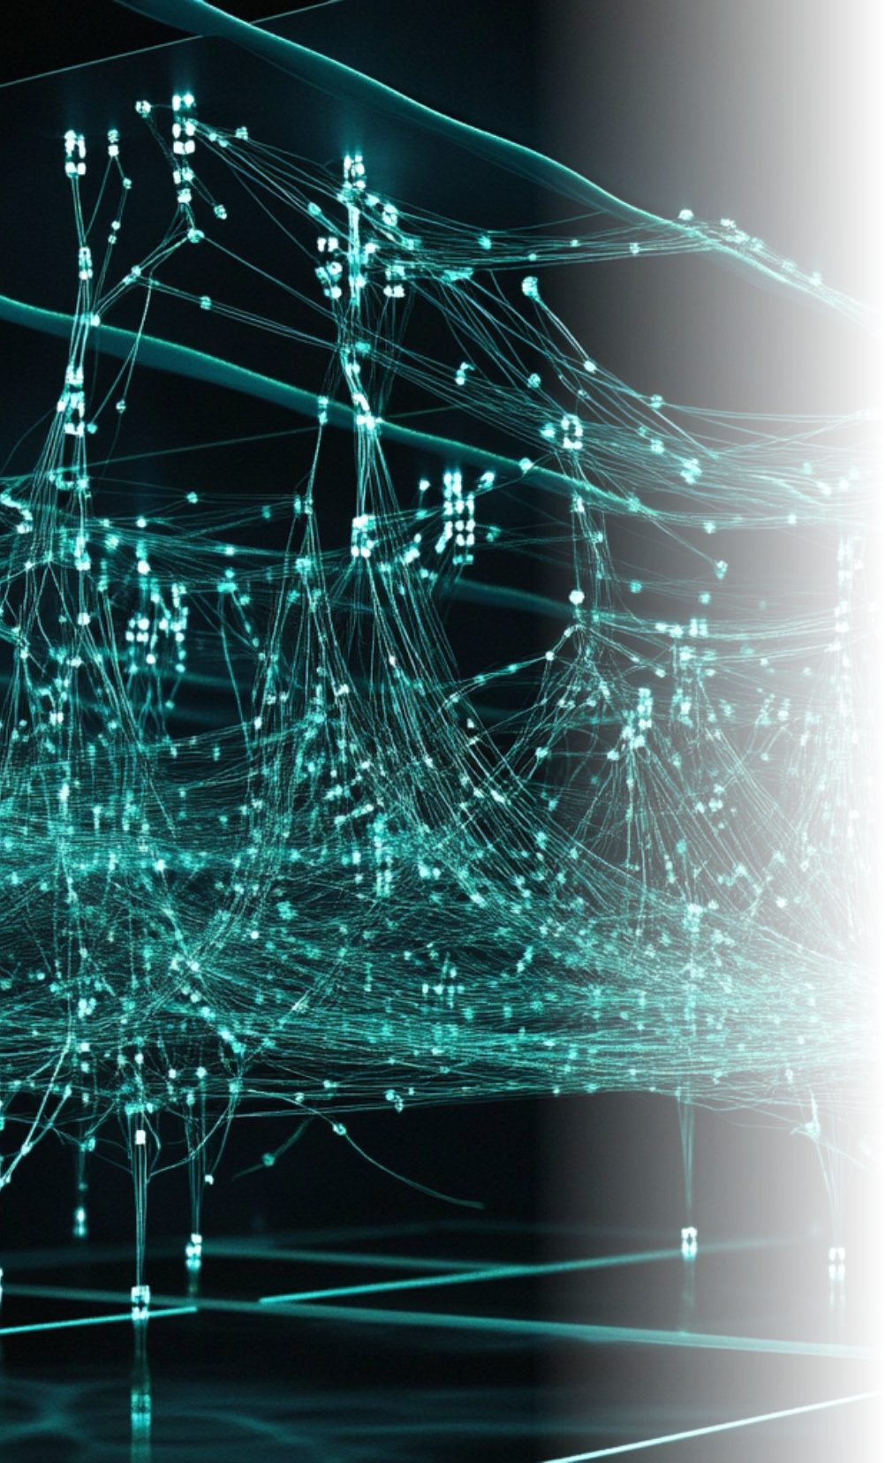
Purpose
Synchronize blockchain across all nodes.

Slide 27

Logic
After mining a block:
•Broadcast it to all peers.
•Peers validate and add it to their chain if valid.

Slide 28

Functions Used
broadcast_block(), receive_block().

Slide 29

09
Summary

Slide 30





Summary
Users create wallets using cryptographic keys.
1
2
Transactions are signed and verified.
Blocks are broadcasted and validated across a decentralized network.
Blocks are mined with proof-of-work and include validated transactions.
4
3

Slide 31

Thank You

